Slide 1


Machine downtime project insights

Slide 2
Contents
Business Objective
Business Constraints
Project Architecture - Data Flow Diagram
Data Collection
Exploratory Data Analysis
Data Visualization
Notes:
Change

Slide 3
Business Problem
Business Problem: Machines which manufacture the pumps. Unplanned machine downtime which is leading to loss of productivity.
Business Objective: Minimize unplanned machine downtime.
Business Constraint: Minimize maintenance cost.
Success Criteria:
Business Success Criteria: Reduce the unplanned machine downtime by at least 10% .
Economic Success Criteria: Achieve a cost saving of at least $1M .

Slide 4
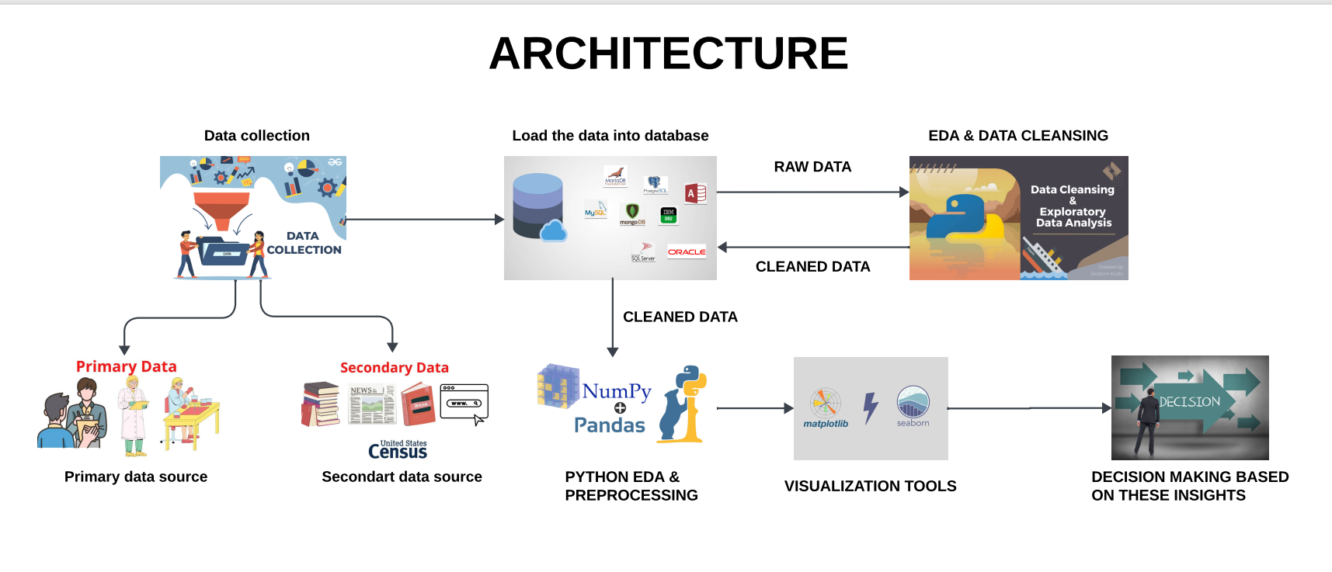
Project Overview and Scope

Slide 5
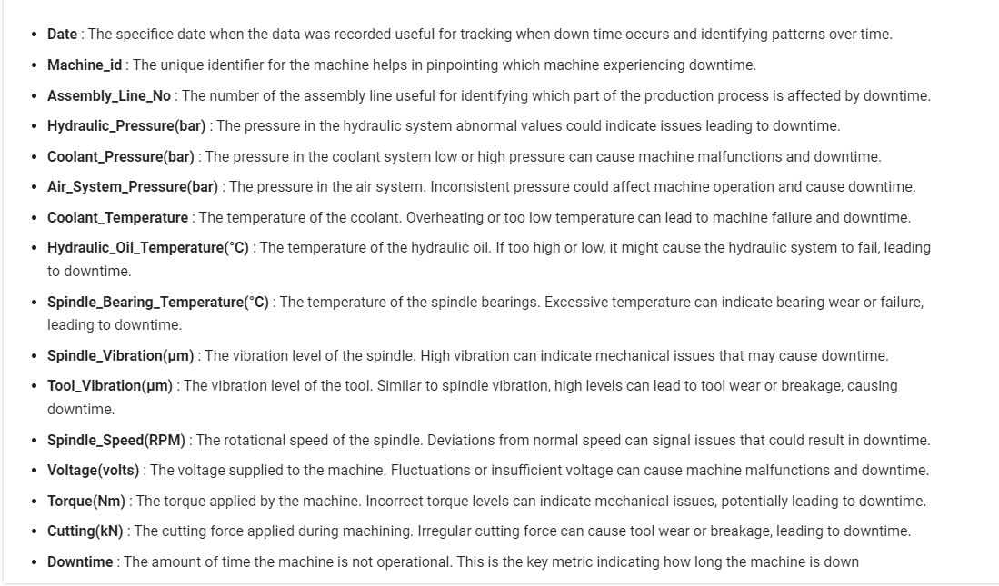
Data Dictionary

Slide 6
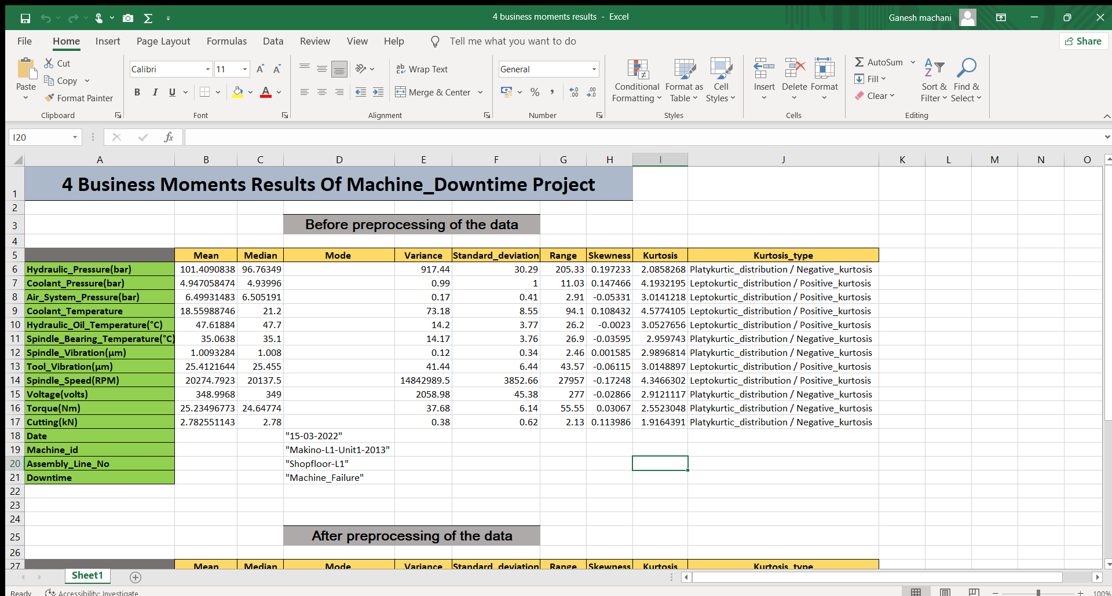
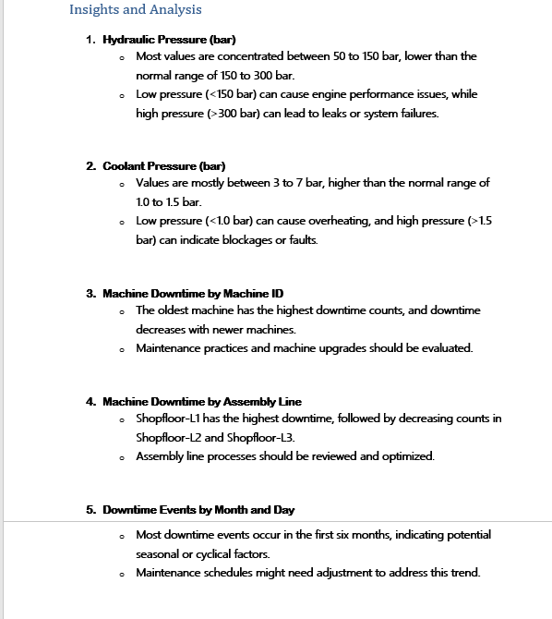
Exploratory Data Analysis [EDA]
Statistical Insights
Business Insights
Notes:
EDA is used for seeing what the data can tell us before the modeling task.
Change

Slide 7
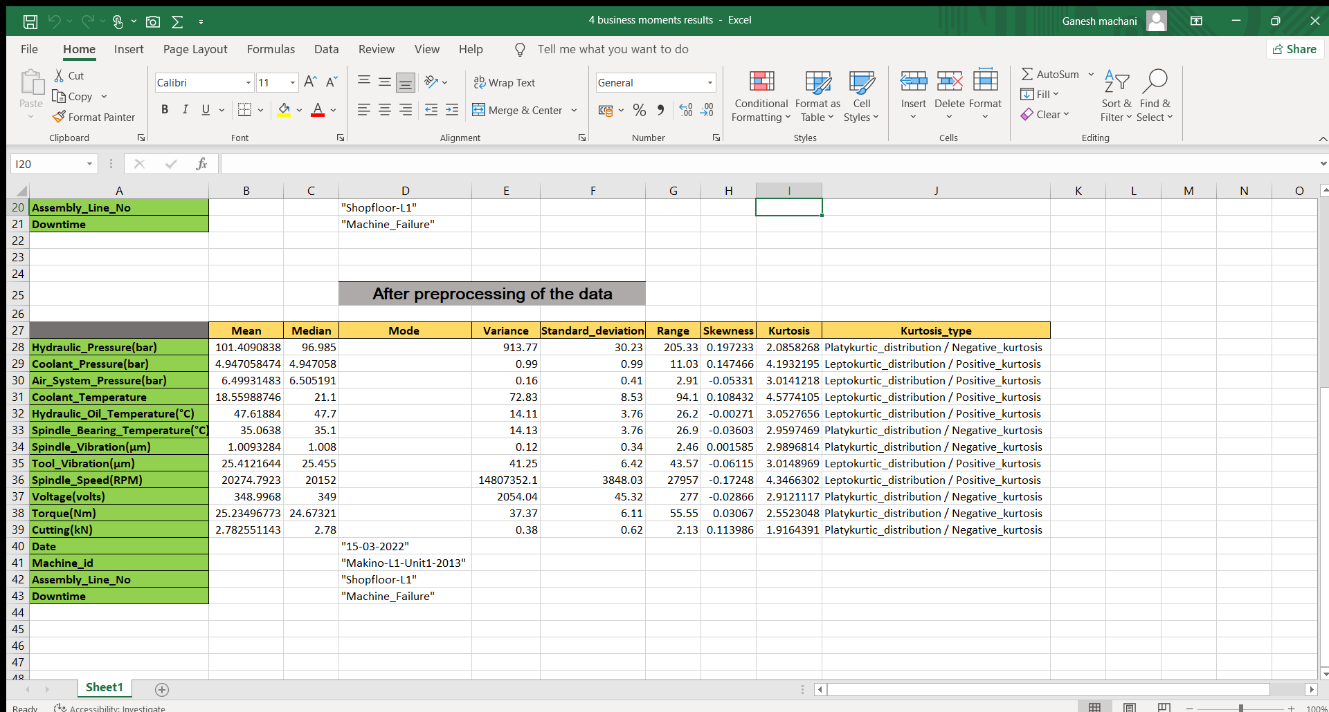
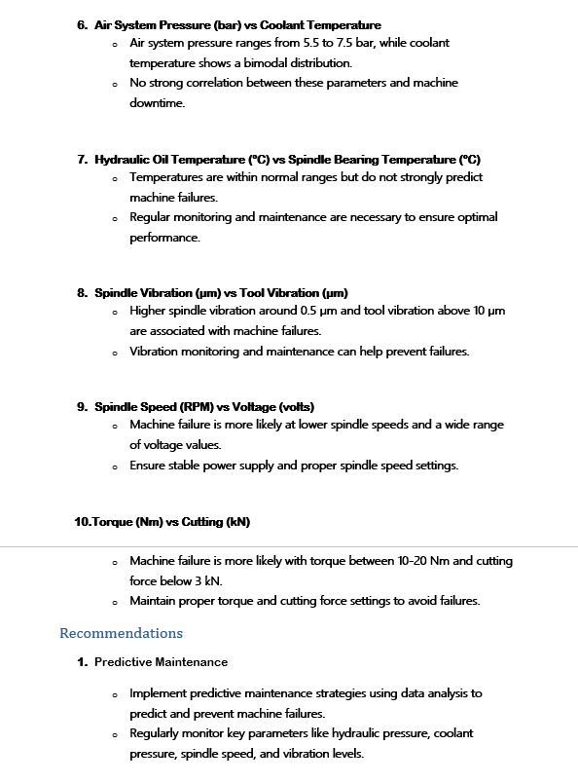
Exploratory Data Analysis [EDA]
Statistical Insights
Business Insights
Notes:
EDA is used for seeing what the data can tell us before the modeling task.
Change

Slide 8
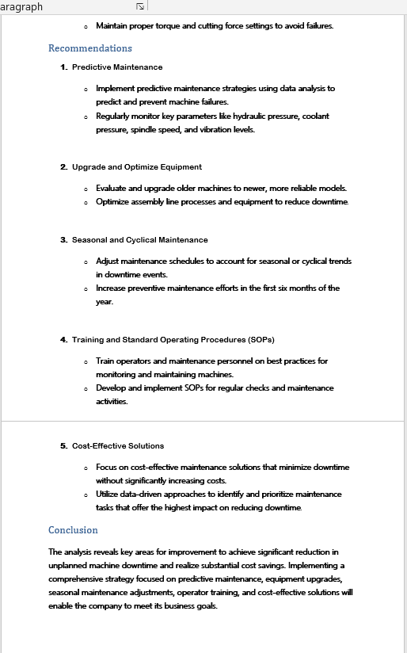
Business Insights

Slide 9
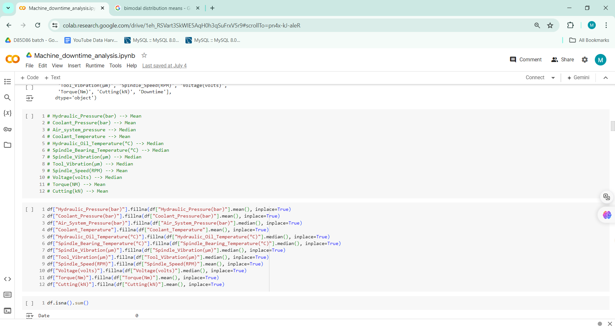
Data Preprocessing
Median imputation is robust for outliers in columns, reducing their impact on the imputed values.
Mean imputation is suitable for columns without outliers, providing a representative average value.
Mode imputation is favored for categorical variables to impute the most frequent value, but may not be ideal for variables with multiple modes or categories where the mode does not reflect the data accurately.
Notes:
Keep observations

Slide 10
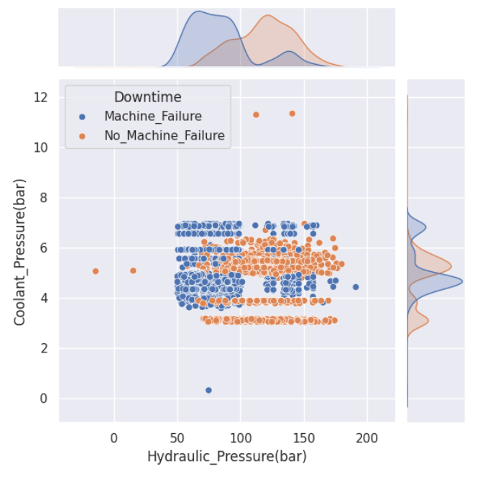
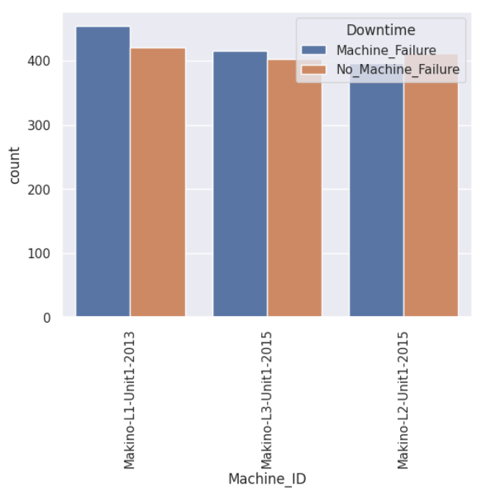
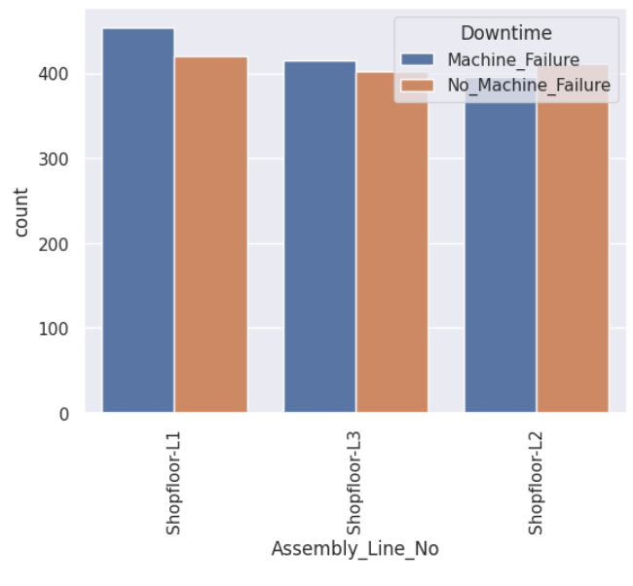
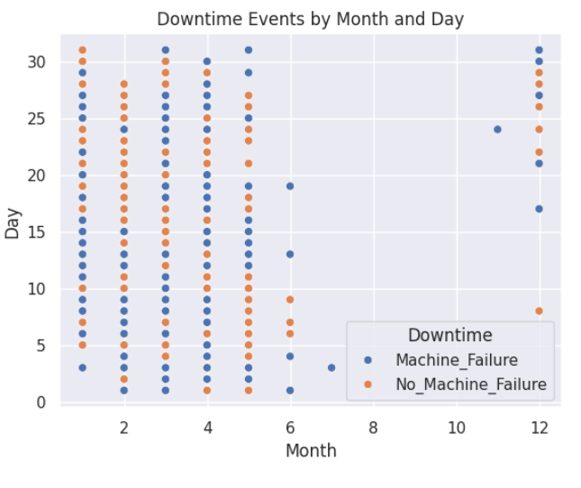
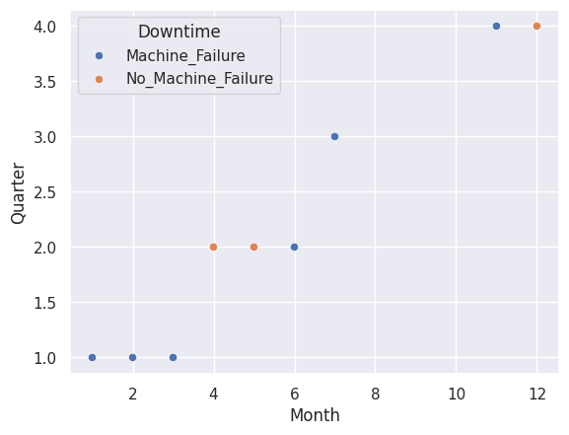
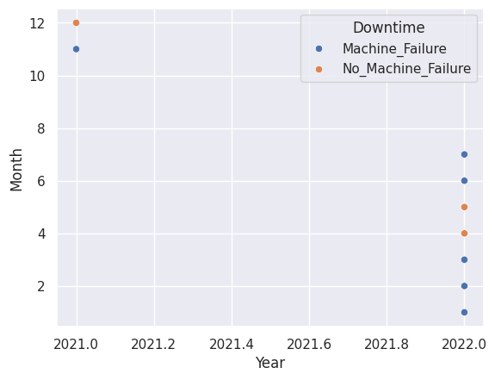
Data Visualization
Notes:
Add graphical

Slide 11
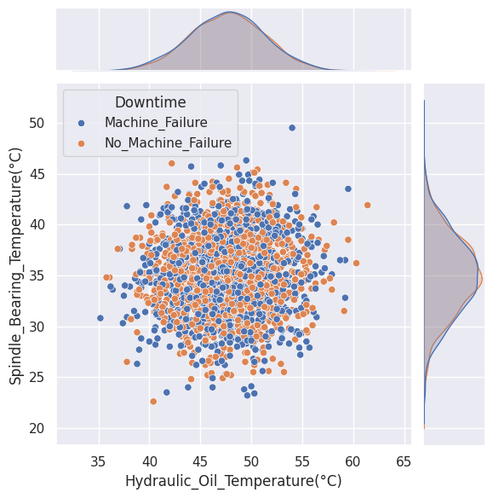
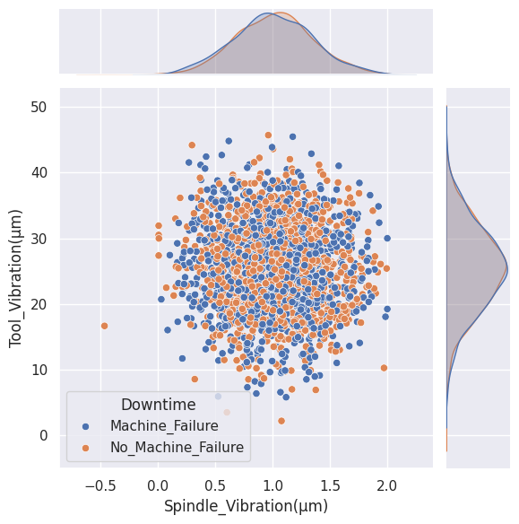
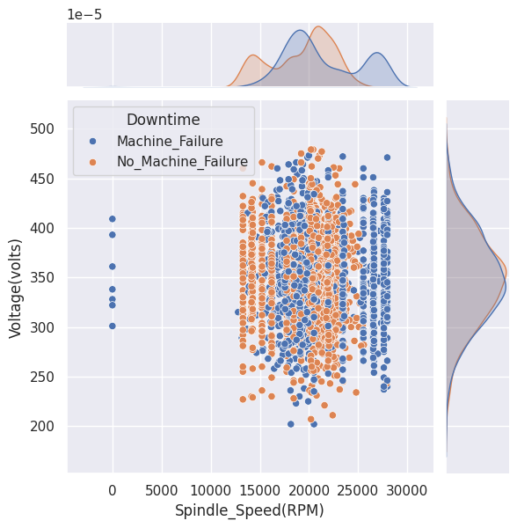
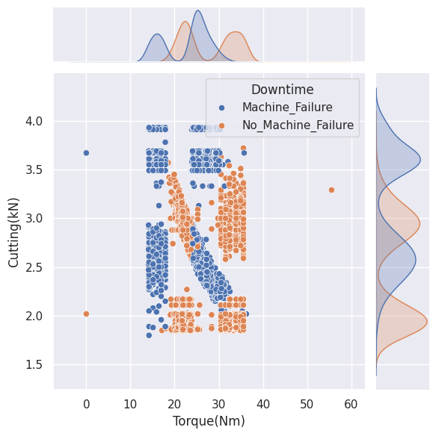
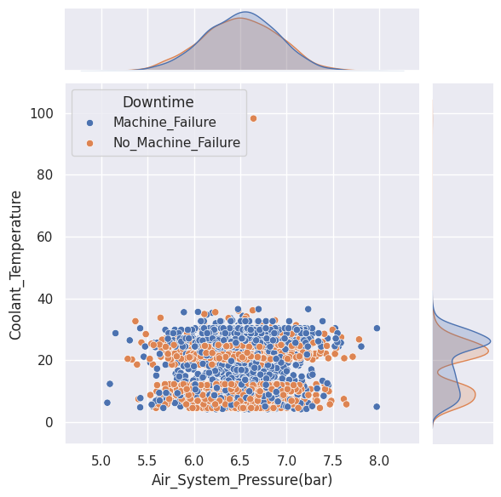
Data Visualization
Notes:
Add graphical

Slide 12


